Slide 1


SIGNIFY
Turning Gestures into Words.
2030

Slide 2
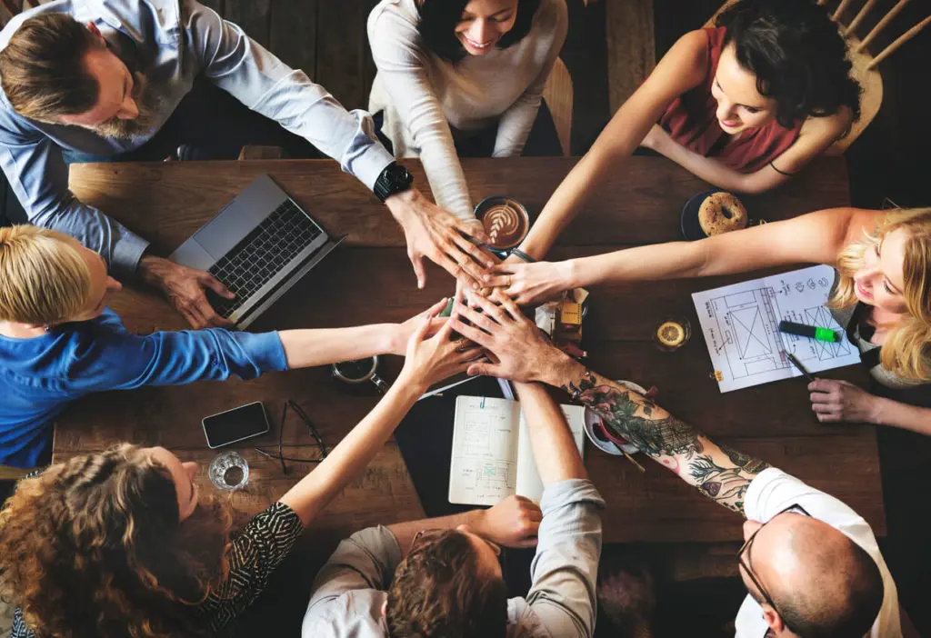
Team members
Yasser Elfar
Anas Eladly
Peter Boules
Abdelrahman salah
Ahmed khafagy
Hamed reda
Supervised by:
Dr. Eman Amin
Ta. Esraa Karam

Slide 3



Agenda
1
Introduction
2
System architecture
3
Functions
4
Algorithms and techniques
5
Dataset
6
Technologies used
7
Running demo
8
Questions

Slide 4
INTRODUCTION

Slide 5
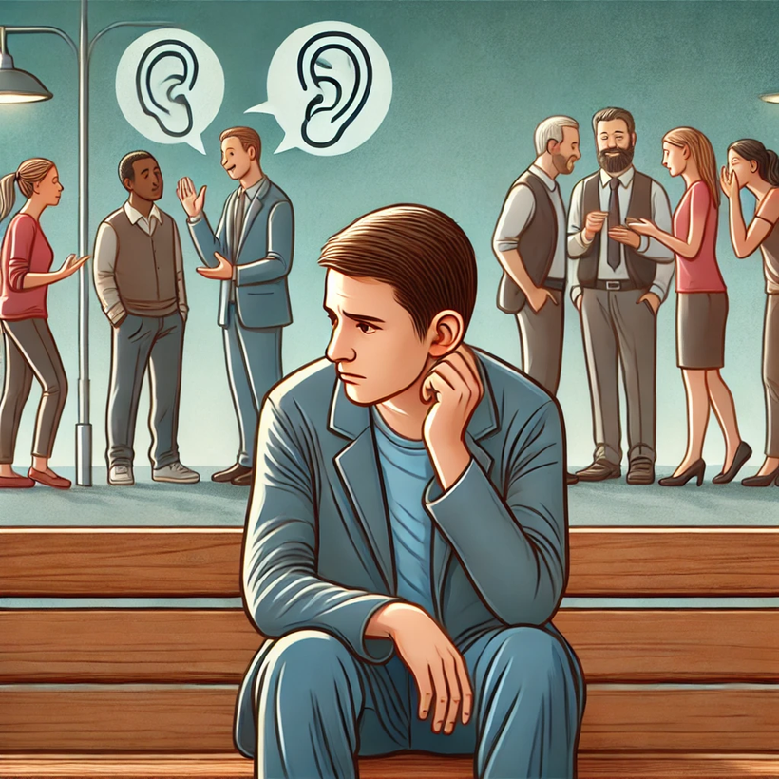
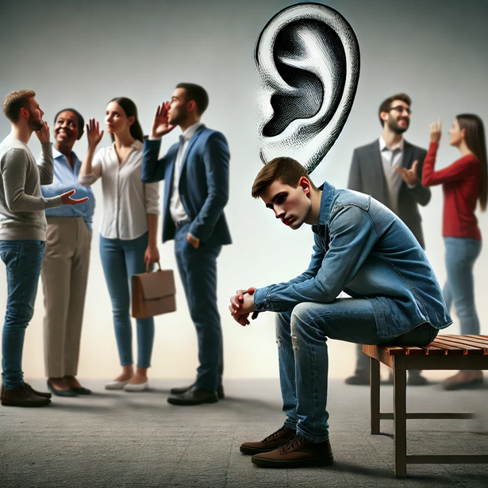
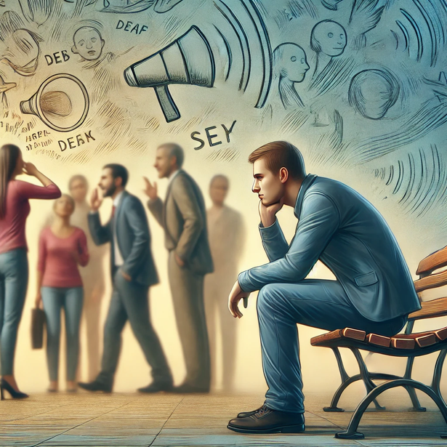
What is the problem ?
people who rely on sign language often struggle to communicate with other people.
this happens because most people don't understand sign language, resulting in a communication barrier that limits disabled people.
This creates a challenge for the sign language community in communicating in everyday interactions.

Slide 6
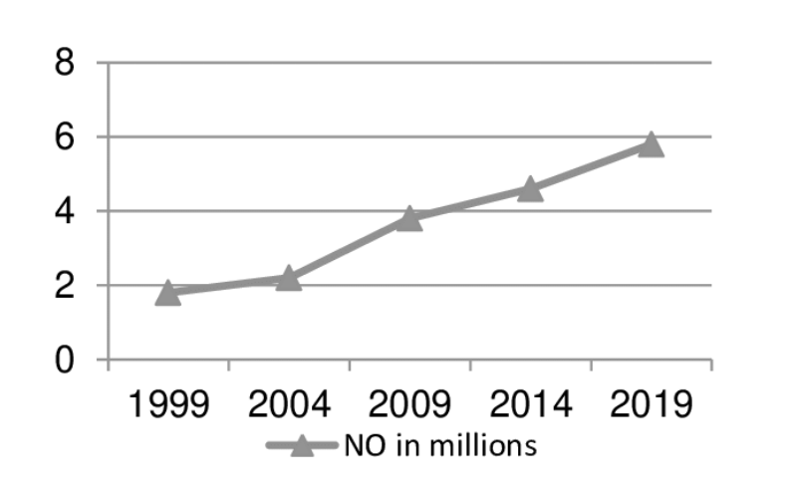
The problem is not small
With over 1.5 billion people affected by hearing loss and millions unable to speak, finding solutions for communication barriers is essential.
As the number of people with disabling hearing loss is expected to rise, developing accessible technologies and inclusive policies is crucial to ensure equal opportunities and improve their quality of life.

Slide 7
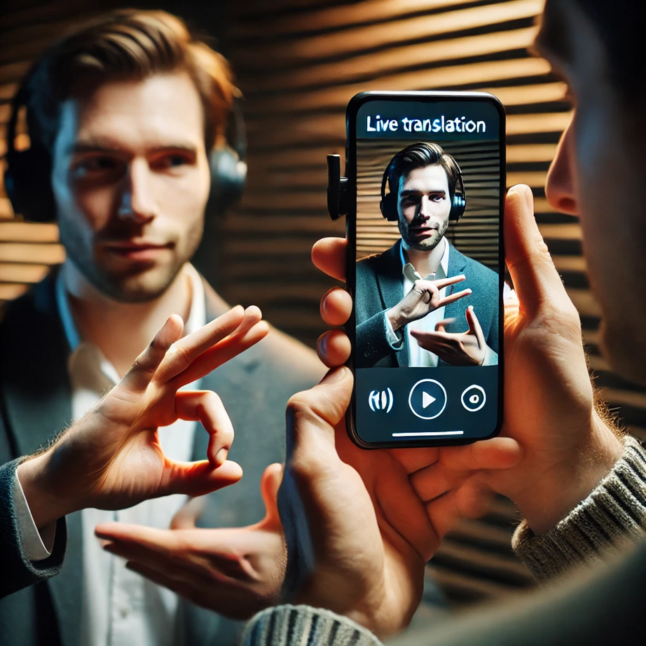
The solution: Signify
Signify provides real-time translation of sign language into spoken or written words.
Users simply record themselves signing, and the system instantly interprets and converts it into text, enabling seamless communication between deaf and hearing individuals.

Slide 8
SYSTEM ARCHITECTURE
2030

Slide 9
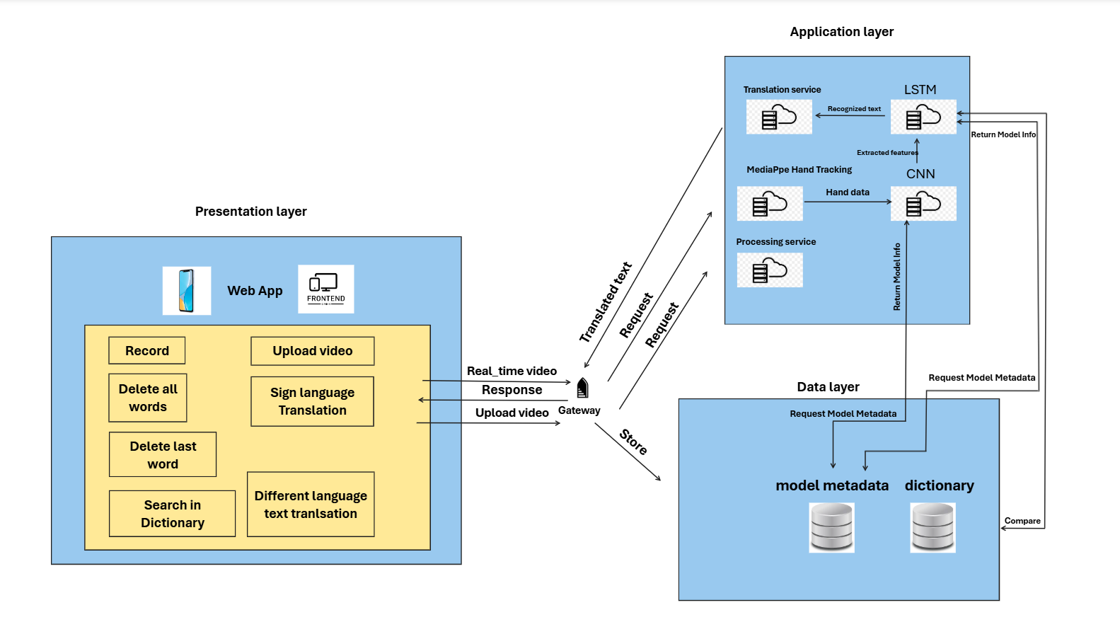

Slide 10
FUNCTIONS
2030

Slide 11
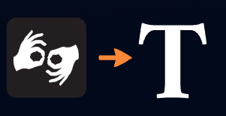


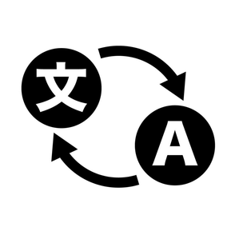
Finished functions
Supported across different platforms
Real time translation
Different languages translation
Sign language Dictionary

Slide 12


Un-Finished functions
Disabled person friendly UI/UX
Translation of Pre-recorded videos

Slide 13
ALGORITHMS &
TECNHIQUES
2030

Slide 14
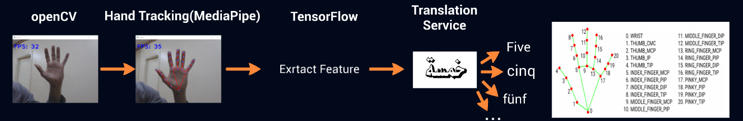
Pre-trained models

Slide 15
Core technologies used
TensorFlow + Keras: Building and training the LSTM model.
NumPy: Handling keypoints and array manipulations.
Scikit-learn: Model evaluation with metrics like accuracy and confusion matrix.
OpenCV + Mediapipe: Image processing and keypoint extraction.
TensorBoard: Monitoring training progress in real-time.

Slide 16
Addition libraries used
Pandas: Reading and processing label mappings.
TQDM: Showing progress bars during data processing.
PIL (Pillow): Rendering Arabic text on images.
ThreadPoolExecutor: Speeding up keypoint extraction via parallel processing.
arabic_reshaper + python-bidi: Ensuring correct display of Arabic text.

Slide 17
DATASET

Slide 18
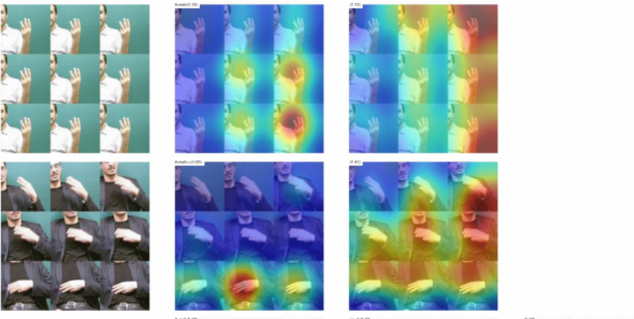
KARSL-502 Dataset
The KARSL-502 datase is a comprehensive collection of 502 unique sign language gestures captured across various contexts.
It contains a diverse set of labeled images representing different signs from the Arabic Sign Language (KARSL).

Slide 19
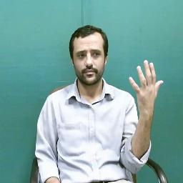
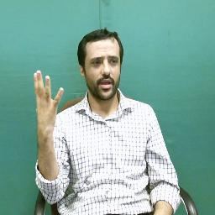
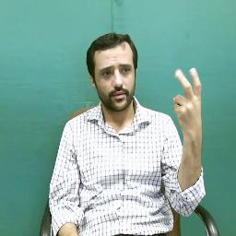
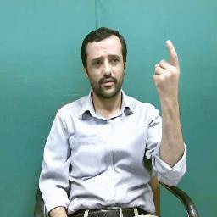
KARSL-502 Data example

Slide 20
TECHNOLOGIES USED

Slide 21
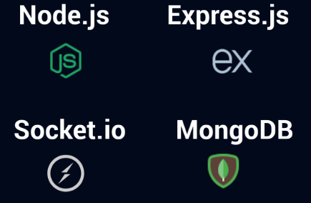


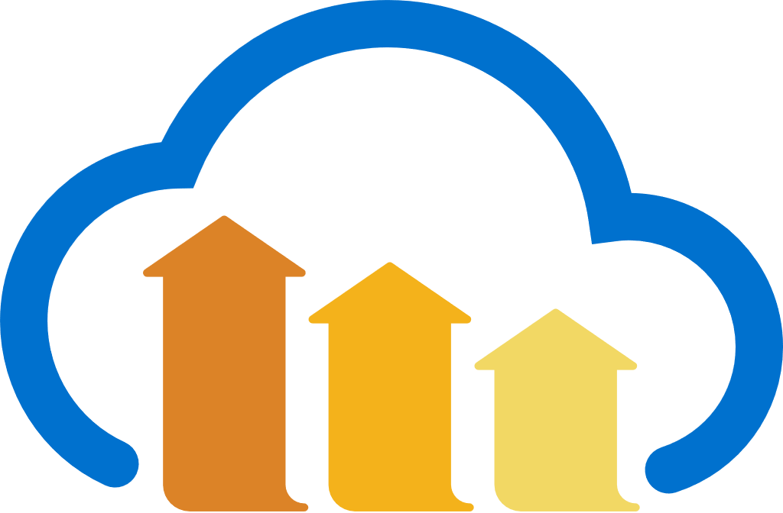
Web Technologies
Front-End
Back-End
React.js
Fast API

Slide 22
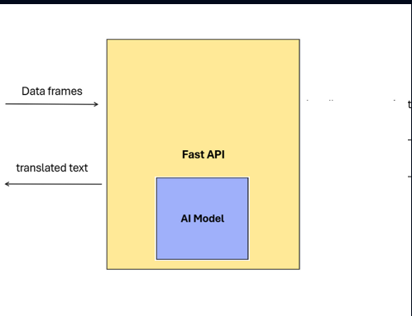
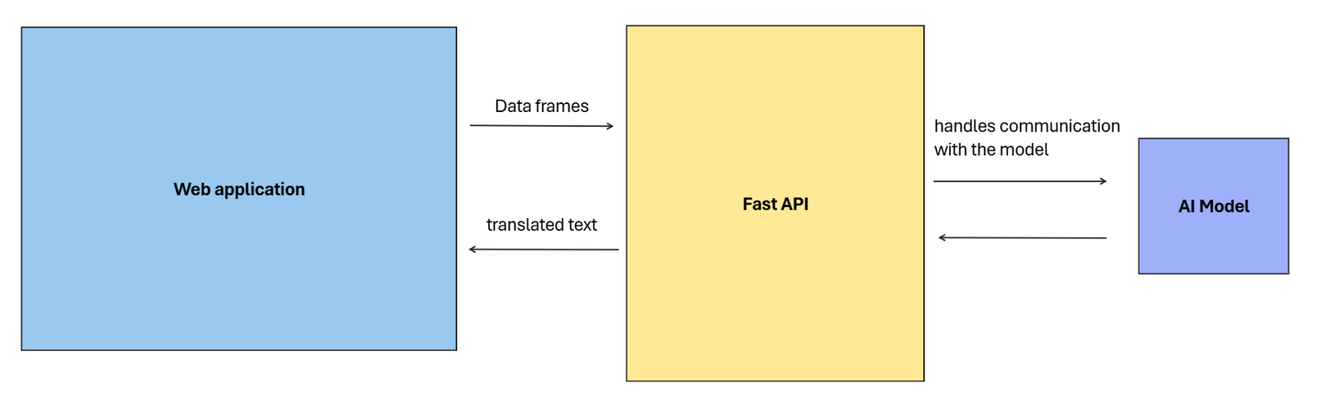
Web application and model linking

Slide 23
WEB APPLICATION
DEMO
2030

Slide 24
2030

Slide 25


Mobile application Technologies
Flutter
Dart
Fast API

Slide 26
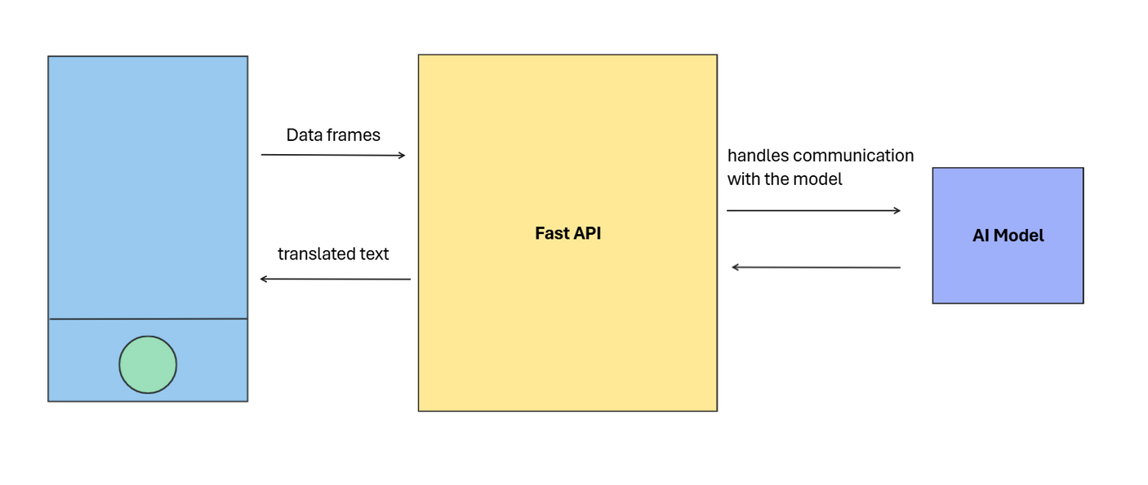
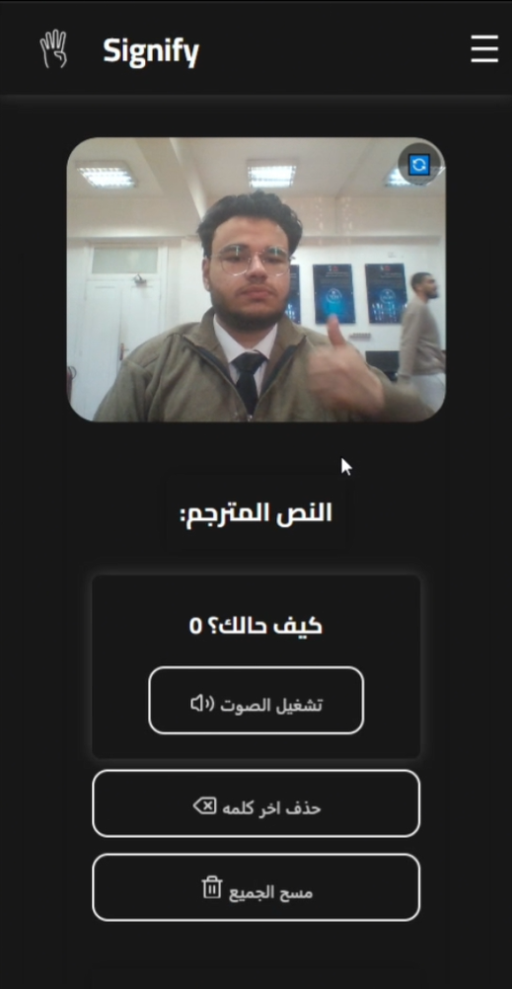
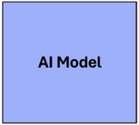
Mobile application and model linking
r
upload
Record
Translation

Slide 27
MOBILE APPLICATION
DEMO
2030

Slide 28
2030

Slide 29
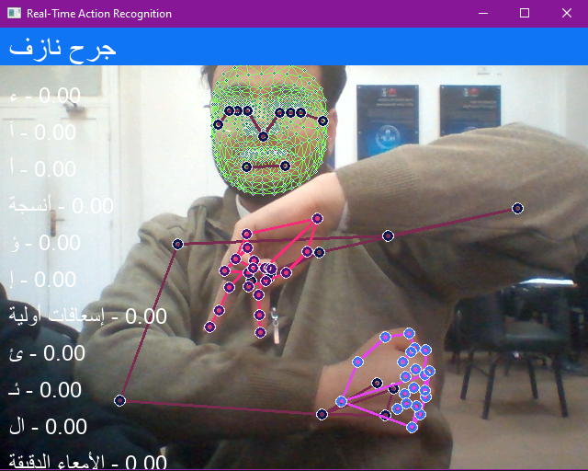
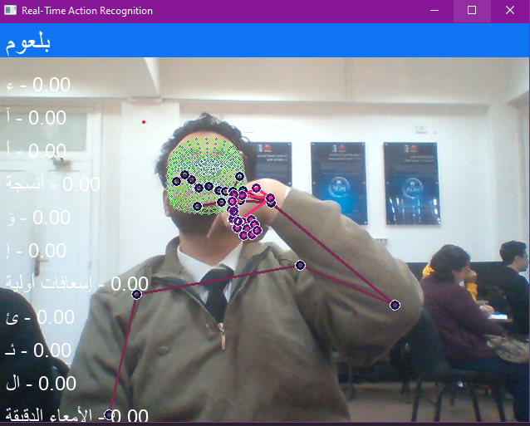
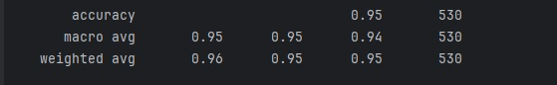
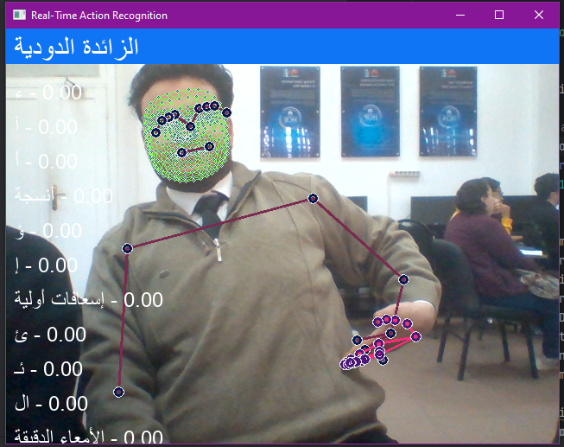
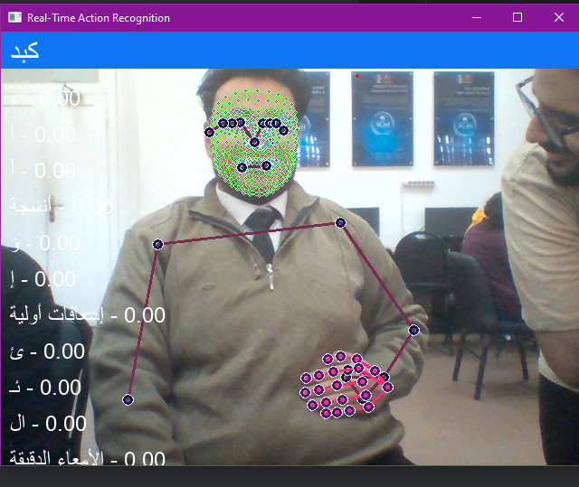
Model Evaluation
2030

Slide 30
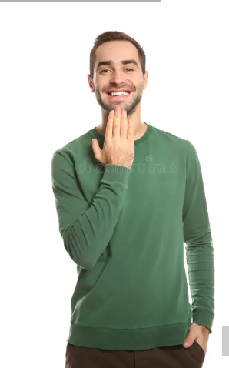
Thank you
Any Questions
Special thanks to
Dr
Eman Amin
Ta. Esraa Karam
Dr

